Slide 1


Project name: Benchtop Environment Sensor Tester (BEST) Team members: Binkley, Weston; Livingston, Tyler; Pahwa, Samarth

Slide 2
Project description
Problem statement: “Sandia National Laboratories would like a consistent, reliable way to ensure that environmental sensors are working. These sensors measure temperature, air pressure, and acceleration.”

Slide 3
Project description
Solution proposal: “Create three electronically controlled environments to separately test accelerometers, thermocouples, and pressure sensors by comparing data against the actual conditions of the environment.”

Slide 4
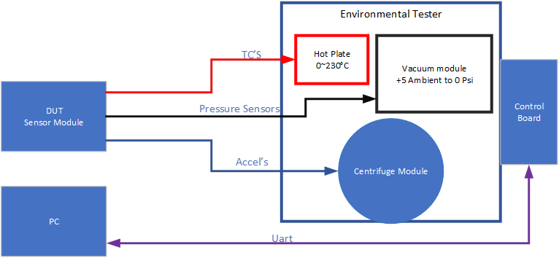
System Overview

Slide 5
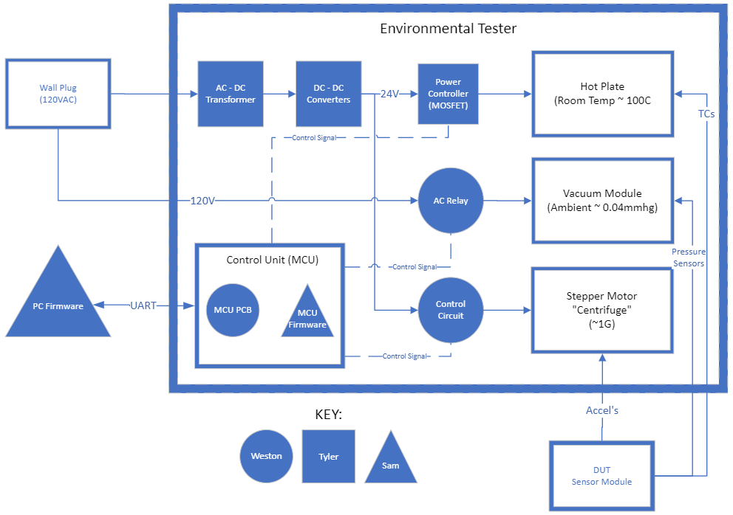
Subsystem Overview

Slide 6
Overall System Progress
The following system parts have been ordered:
Microchip PIC18F24Q10
Microchip Curiosity Development Board
Adafruit Stepper Motor
Vevor Vacuum Pump
Creality Hot Plate

Slide 7
Power Subsystem
Completed:
AC-DC Power Supply ordered
Design of 3 DC-DC Buck Converters
36V to 24V 9.2A
36V to 12V 0.33A
12V to 5V 0.5A
Simulated designs
To Do:
Design FET Driver to power Hot Plate
PCB design

Slide 8
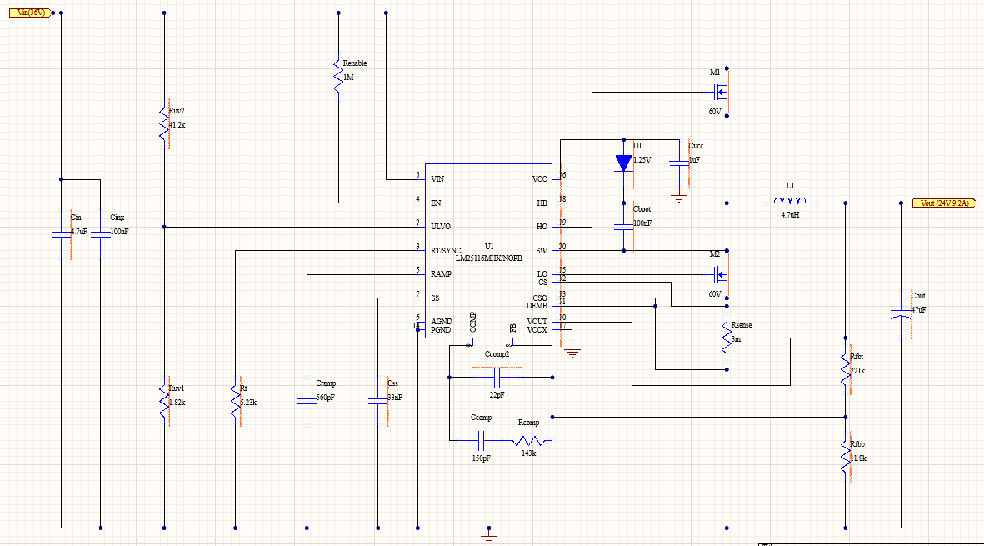
Altium Schematic: 36V to 24V Buck Converter

Slide 9
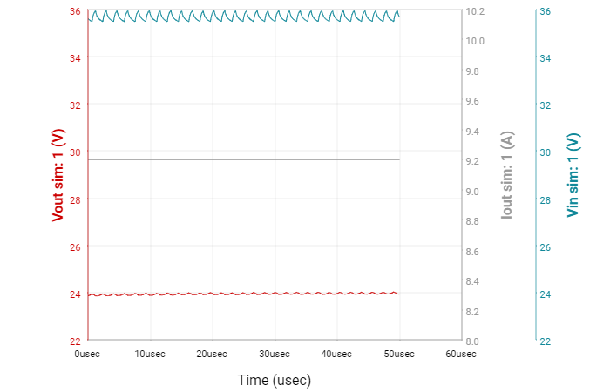
Simulation

Slide 10
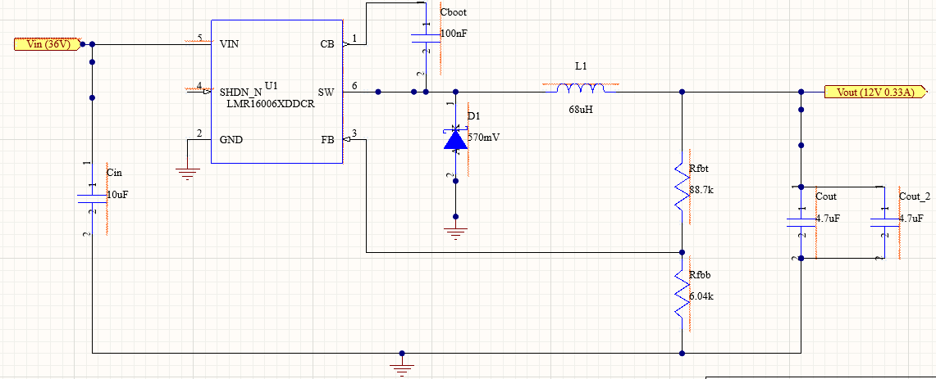
Altium Schematic: 36V to 12V Buck Converter

Slide 11
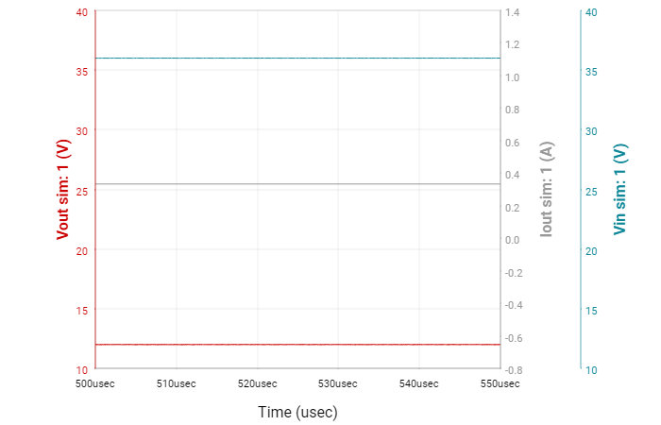
Simulation

Slide 12
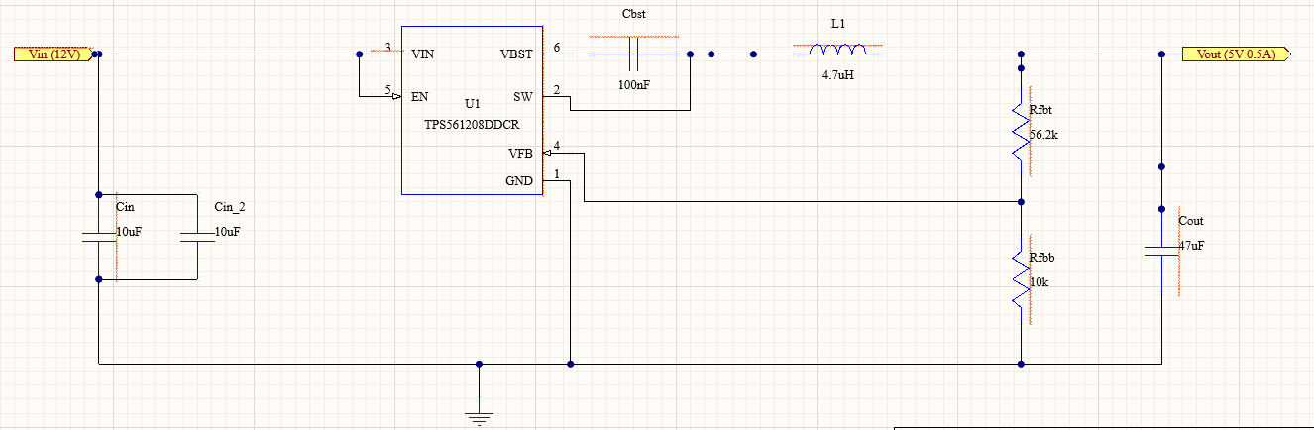
Altium Schematic: 12V to 5V Buck Converter

Slide 13
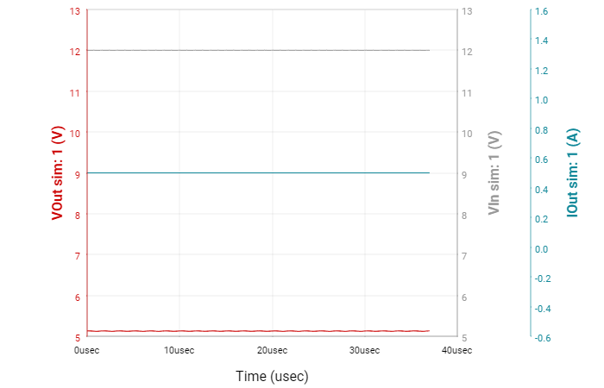
Simulation

Slide 14
Firmware Subsystem
Completed:
IDE installed on machine for simulation (MPLAB X IDE)
Began reviewing code for integration
To Do:
Write C code for MCU to 3 different environments
Write PC application code

Slide 15
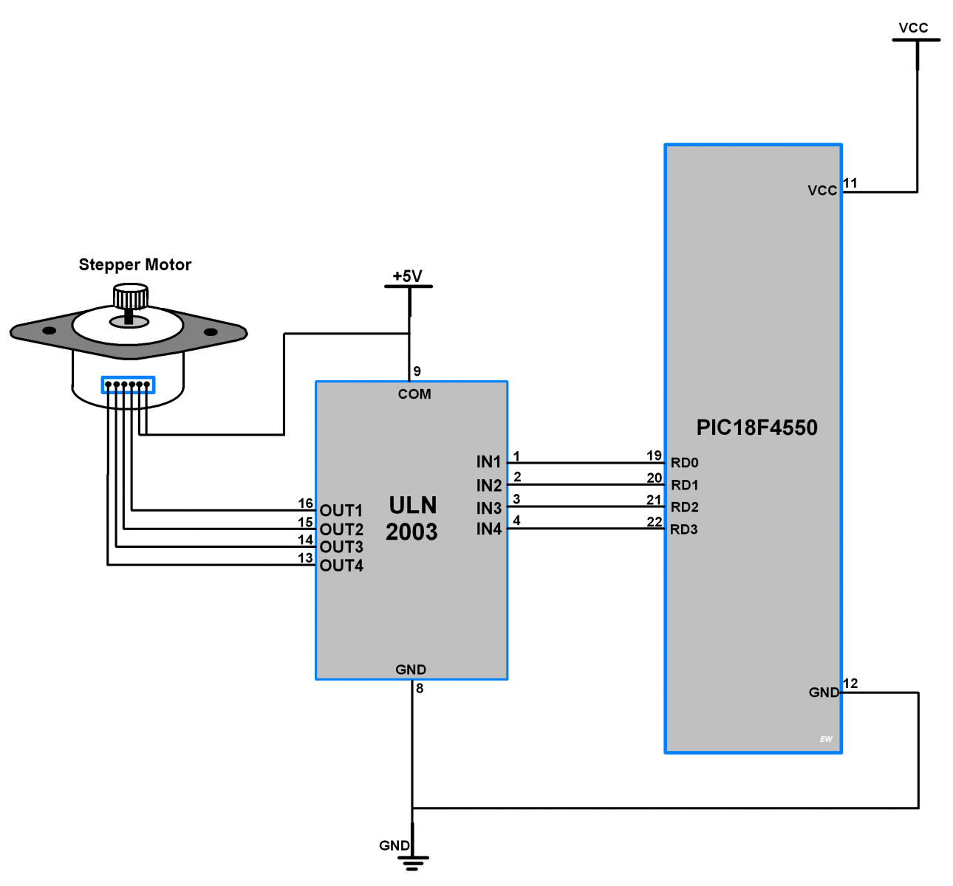
Example schematic motor driver to PIC18F MCU

Slide 16
Example code of stepper motor control
/*
* Stepper Motor Control using PIC
* http://www.electronicwings.com
*/
#include <pic18f4550.h>
#include "Configuration_header_file.h"
void MSdelay(unsigned int val)
{
unsigned int i,j;
for(i=0;i<val;i++)
for(j=0;j<165;j++);
}
void main(void)
{
int period;
OSCCON = 0x72; /* Use Internal Oscillator 8MHz */
TRISD = 0x00; /* Make PORTD as output */
period = 100; /* Set period in between two steps */
while (1)
{
/* Rotate Stepper Motor clockwise with Half step sequence */
for(int i=0;i<12;i++)
{
LATD = 0x09;
MSdelay(period);
LATD = 0x08;
MSdelay(period);
LATD = 0x0C;
MSdelay(period);
LATD = 0x04;
MSdelay(period);
LATD = 0x06;
MSdelay(period);
LATD = 0x02;
MSdelay(period);
LATD = 0x03;
MSdelay(period);
LATD = 0x01;
MSdelay(period);
}

Slide 17
Example code of stepper motor control
LATD = 0x09; /* Last step to initial position */
MSdelay(period);
MSdelay(1000);
/* Rotate Stepper Motor Anticlockwise with Full step sequence */
for(int i=0;i<12;i++)
{
LATD = 0x09;
MSdelay(period);
LATD = 0x03;
MSdelay(period);
LATD = 0x06;
MSdelay(period);
LATD = 0x0C;
MSdelay(period);
}
LATD = 0x09;
MSdelay(period);
MSdelay(1000);
}
}

Slide 18
Electronics Subsystem
Completed:
Selected and ordered microprocessor
Began reviewing documentation and datasheets
Outlined all the components that the MCU needs to interface
To Do:
Finalize feedback sensors
Generate a list of MCU pin assignments
Design and order PCB

Slide 19
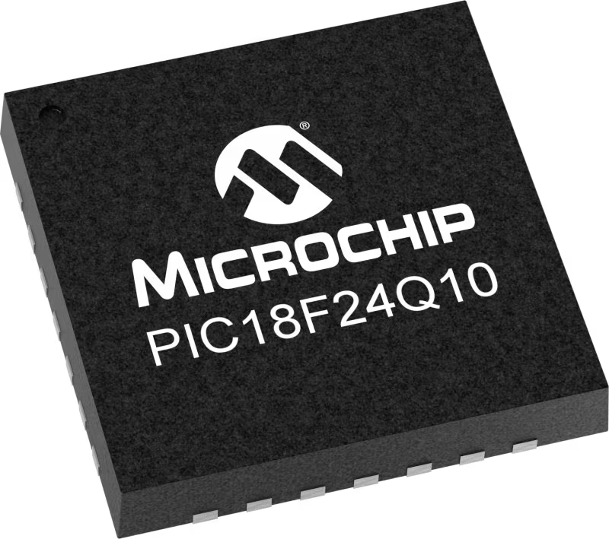
Electronics Subsystem
Air pressure sensor
120V AC Relay
Stepper Motor Driver
PC Application
Accelerometer
Hot Plate Driver

Slide 20
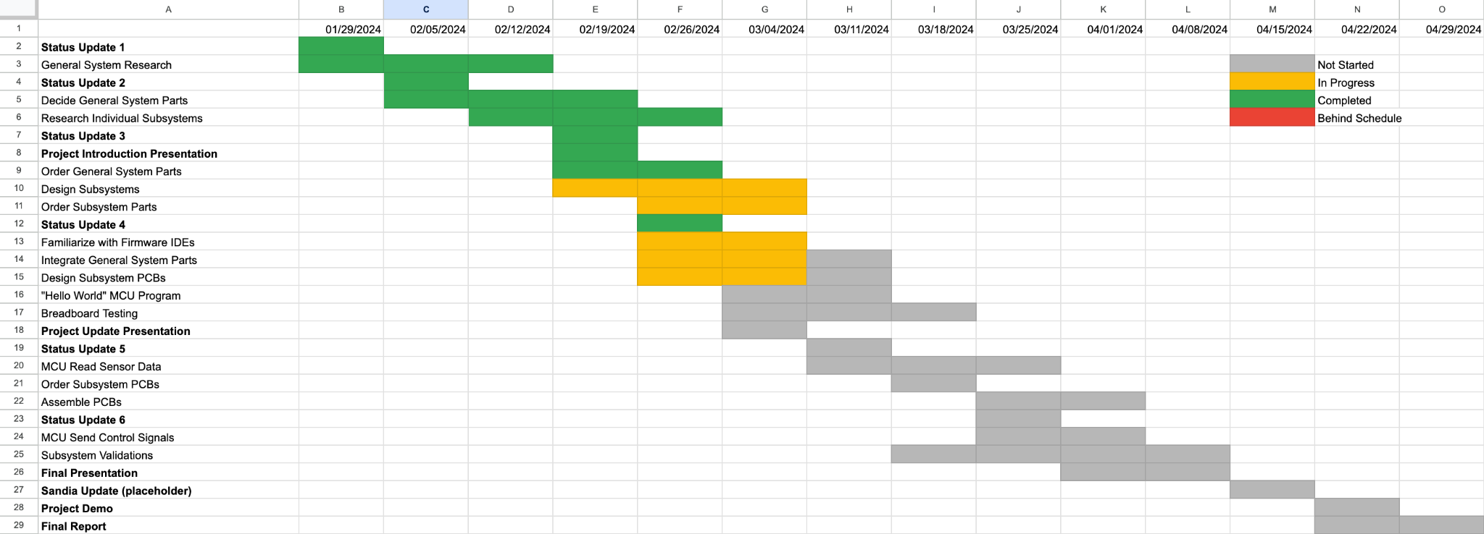
Execution Plan

